Slide 1

Installing VirtualBox

Slide 2
VirtualBox
VirtualBox is a cross-platform virtualization software
Opensource
Easy to setup
on Windows - Linux, Solaris, Mac OS X
create and run multiple VM’s,
running different operating systems,
on the same computer
at the same time.

Slide 3
Windows

Slide 4
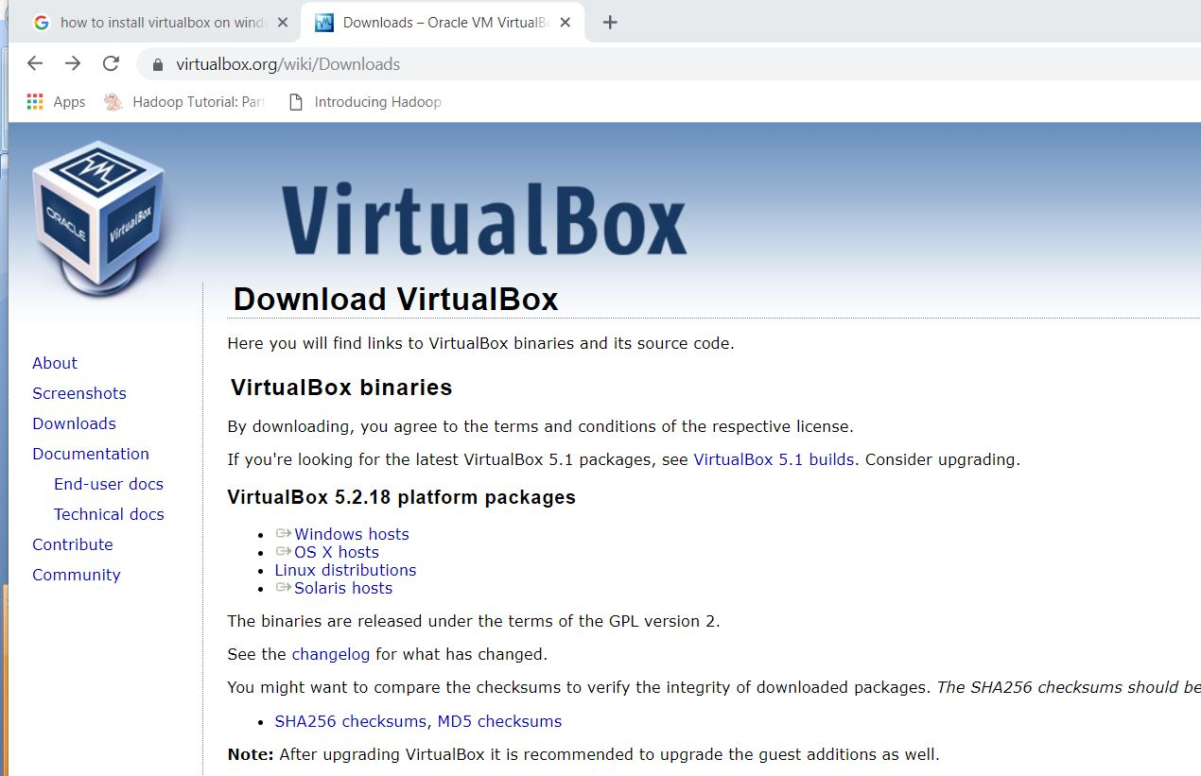
Oracle VM VirtualBox - Download
https://www.virtualbox.org/wiki/Downloads
Click on Windows hosts

Slide 5
Installation Steps – Windows 10
Steps to follow:
1) Click on ‘Windows hosts’
2) The .exe file will start downloading
VirtualBox-5.2.18-124319-Win.exe
3) Go to Downloads folder
4) Right click on the .exe file Run as Administrator

Slide 6
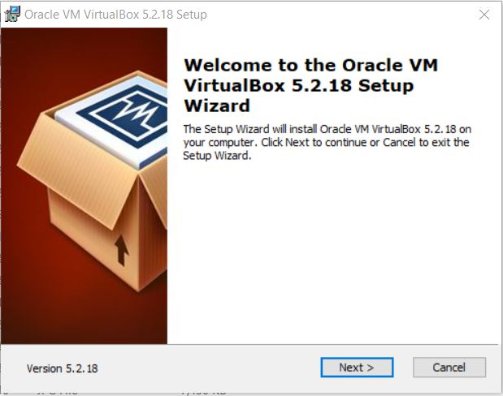
Installation Steps

Slide 7
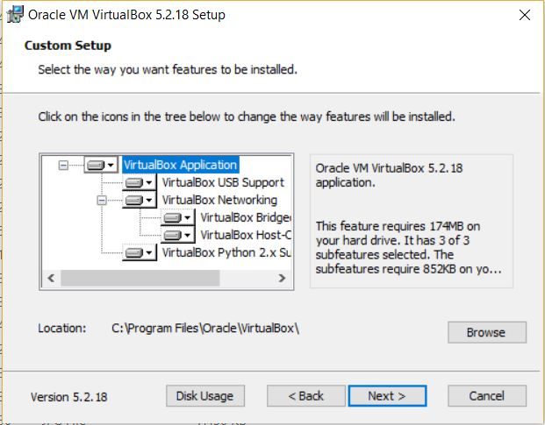
Installation Steps

Slide 8
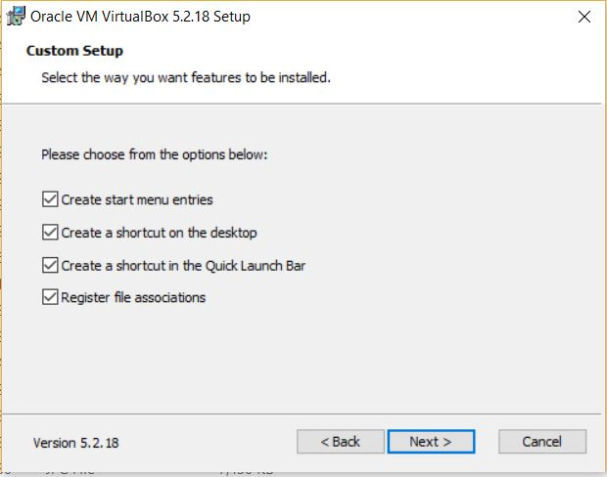
Installation Steps

Slide 9
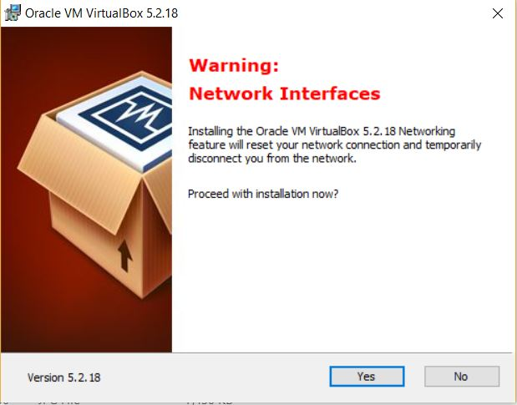
Installation Steps

Slide 10
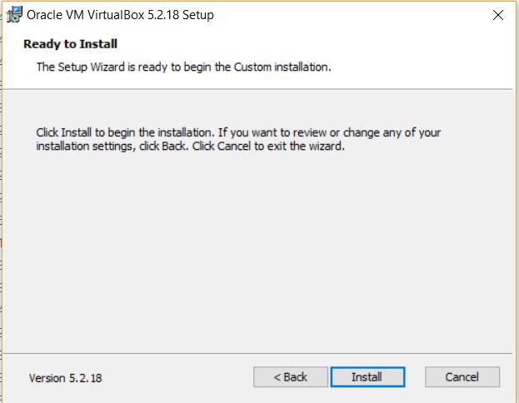
Installation Steps

Slide 11
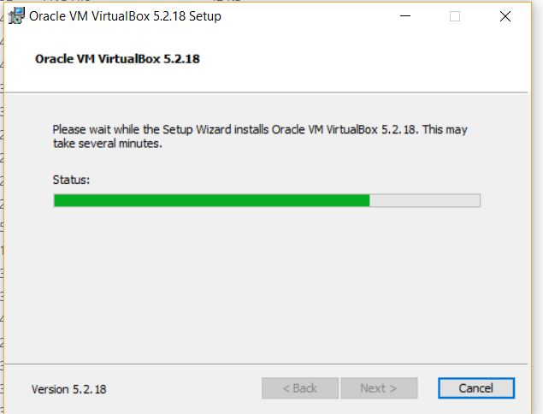
Installation Steps

Slide 12
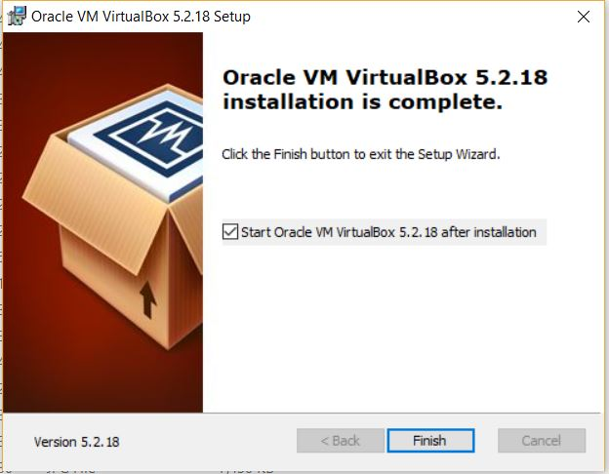
Installation Steps

Slide 13
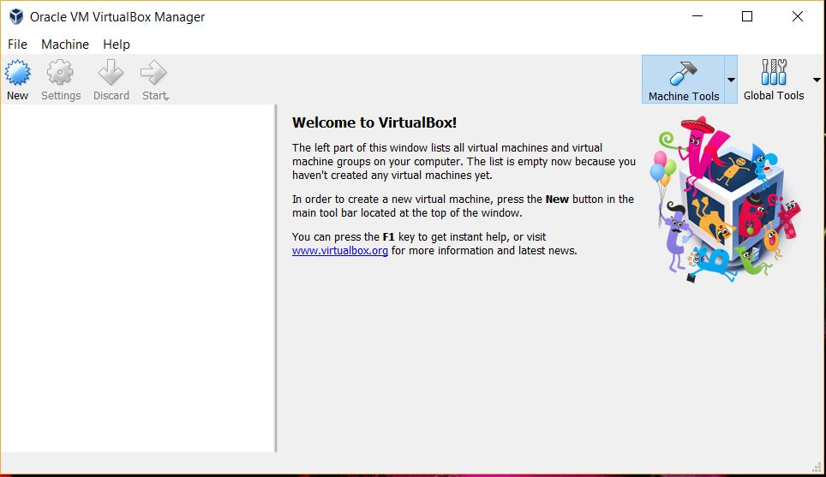

Oracle VM VirtualBox – Windows 10
Desktop Icon

Slide 14
CentOS

Slide 15
Oracle VM VirtualBox - Download
https://www.virtualbox.org/wiki/Downloads
Click on Linux Distributions

Slide 16
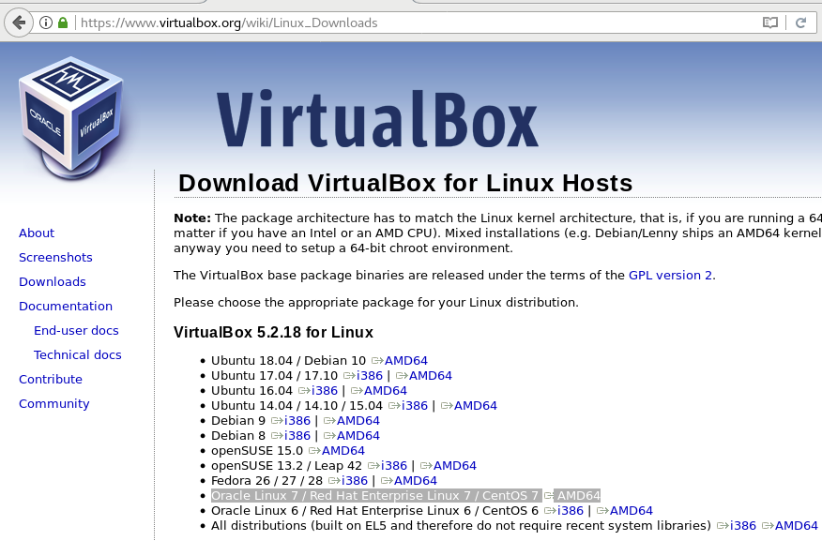
CentOS 7
https://www.virtualbox.org/wiki/Linux_Downloads
Select the version

Slide 17
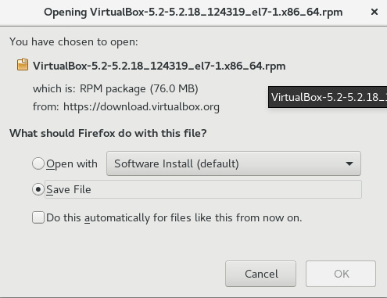
Installation Steps - CentOS 7

Slide 18
Installation Steps
1) Open the Terminal
Application(top-left corner) → Terminal
2) Check the current directory
$ pwd
For example,
Output: /home/dbpsysads
3) Move to Downloads folder
$ cd Downloads/

Slide 19
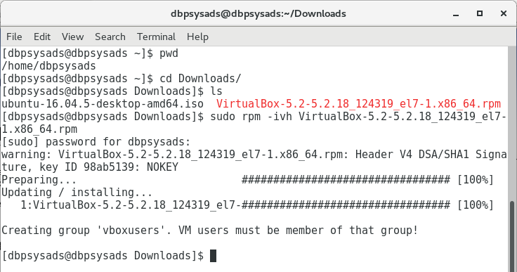
Installation Steps
4) Command to install the package .rpm
$ sudo rpm -ivh VirtualBox-5.2_5.2.18-124319_el7-1.x86_64.rpm

Slide 20
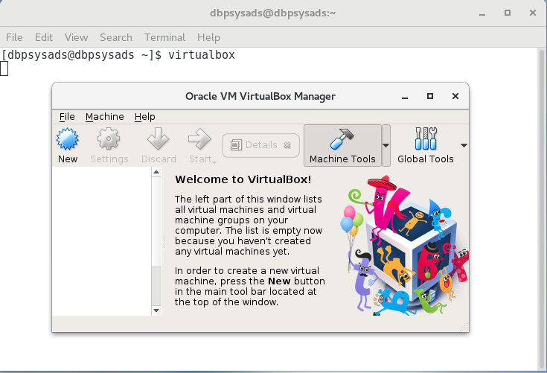
Oracle VM VirtualBox – CentOS 7
5) $ virtualbox

Slide 21
Ubuntu

Slide 22
Installation Steps – Ubuntu 16.04
1) Open the Terminal
Keyboard Shortcut → Ctrl + Alt + T
2) Add VirtualBox Repository Key
$ wget -q https://www.virtualbox.org/download/oracle_vbox_2016.asc -O- | sudo apt-key add -
$ wget -q https://www.virtualbox.org/download/oracle_vbox.asc -O- | sudo apt-key add -

Slide 23
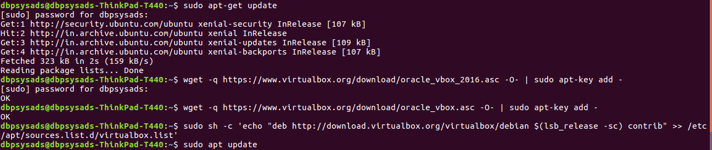
Installation Steps
3) Add VirtualBox Repository
sudo sh -c 'echo "deb http://download.virtualbox.org/virtualbox/debian $(lsb_release -sc) contrib" >> /etc/apt/sources.list.d/virtualbox.list'

Slide 24
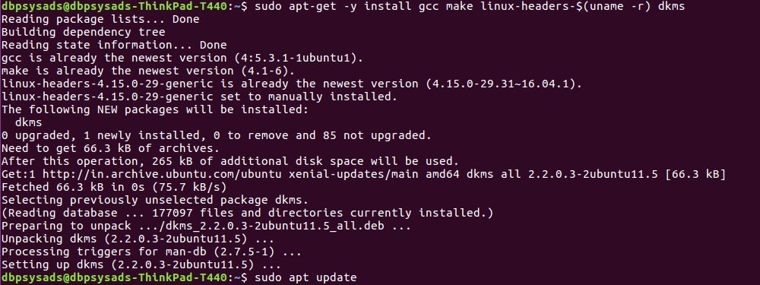
Installation Steps
4) $ sudo apt-get update
5) $ sudo apt-get -y install gcc make linux-headers-$(uname -r) dkms
6) $ sudo apt-get update

Slide 25
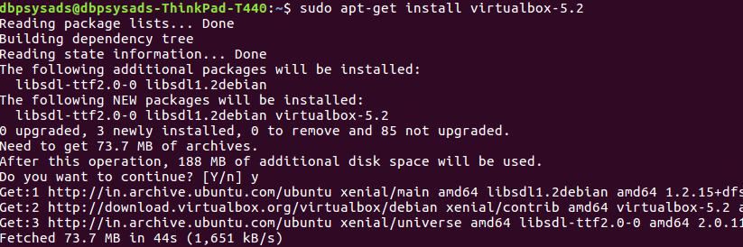
Installation Steps
$ sudo apt-get install virtualbox-5.2

Slide 26
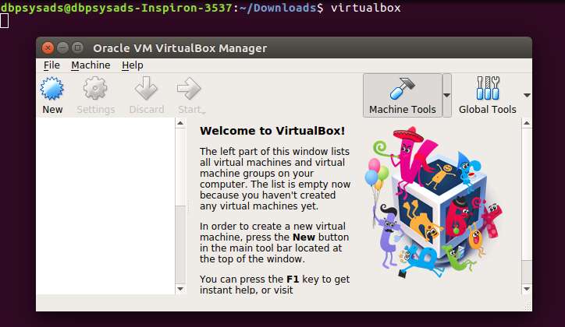
Oracle VM VirtualBox – Ubuntu16.04
5) $ virtualbox

Slide 27
Thank You!

